Slide 1

Gender Identity
& Personal Pronouns
Notes:
Hi. My name is Bryanna Snyder. I use the pronouns she and her. Today, I will be presenting on Gender Identity and personal pronouns.

Slide 2
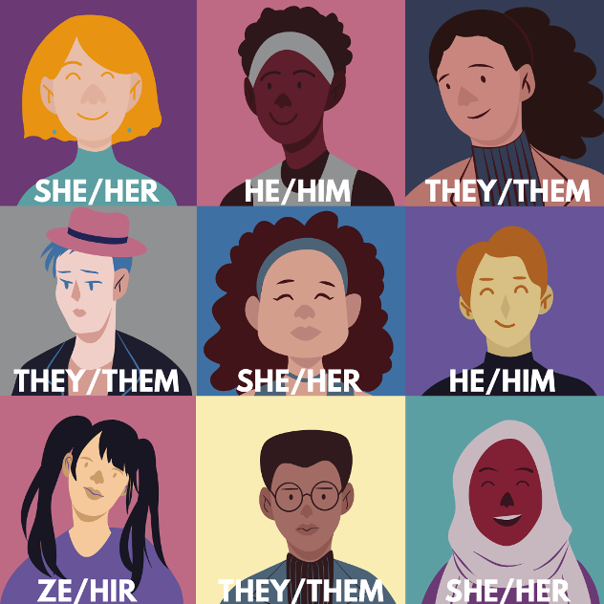
Introduction
We are in a social movement to respect people’s personal pronouns. We have begun listing them in our bios and our email signatures, but we have yet to migrate it to everyday use. Pronoun are not just important at work, but everywhere. It is an easy way to show respect, and many people do not know how to navigate these conversation and this campaign would aim to help them.
Notes:
https://www.edi.nih.gov/blog/communities/what-are-gender-pronouns-why-do-they-matter

Slide 3


Account Goals
Facebook
Promote Gender Identity Conversations
Grow campaign awareness
Instagram
Increase followers
Grow likes and shares
Twitter
Increase followers
Grow mentions and shares

Slide 4
Social Media Accounts
Facebook
Instagram
Twitter
Launch campaign from current account.
Use Images, text, and audio/video to spread awareness.
Add groups like the ACLU, LGBT Advocate, Transgender Support, Parents of Transgender Children, LGBT Pride Support
Create a new account
Use images and audio/video
Use hashtag PronounsMatter
Add accounts like LGBT History, Amber Leventry, Billy Porter, Queer Kid Stuff, Damian Animated, A Pinch of Pride
Create a new account
Use text and some images
Use hashtag PronounsMatter
Add accounts like LGBT, Sally Kohn, Ethan Frey, Dominic Holden, HRC, The Trevor Project, GLSEN

Slide 5
Posting Details
 | Facebook | Instagram | Twitter
Days | Monday - Friday | Monday - Saturday | Monday, Wednesday, Friday
Times | 9-11am | 10-12pm, 9am | 9am
Occurrences | Once each day | Once each day | Once each day
Content | Images, Videos, Text | Images, Audio/Video | Text
Notes:
https://sproutsocial.com/insights/best-times-to-post-on-social-media/

Slide 6
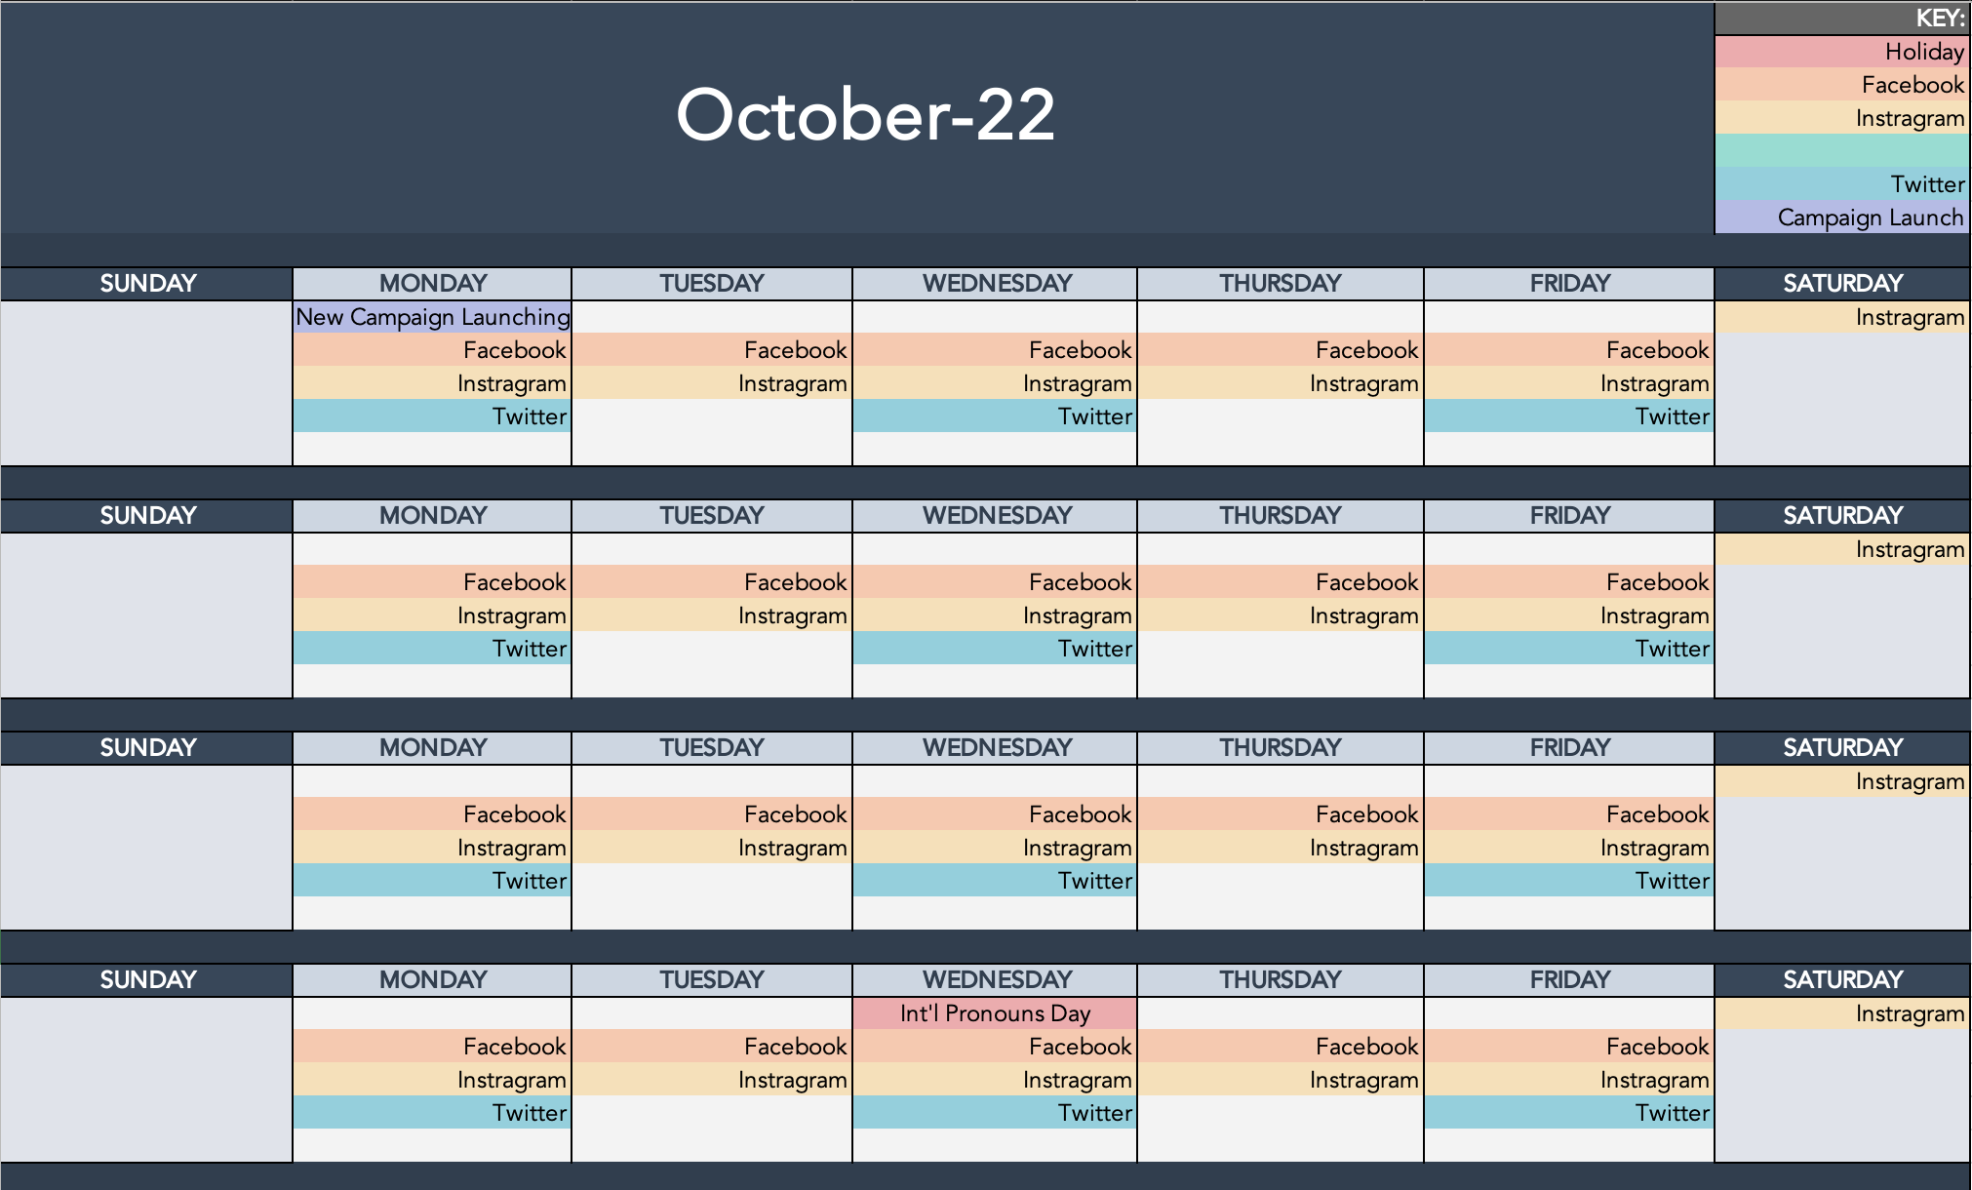
Campaign Calendar
Notes:
International Pronouns Day is October 19th. The campaign would launch on September 26th, a little over three weeks prior to the day to introduce, remind, and teach people about how to use and ask for pronouns in day to day conversations.

Slide 7
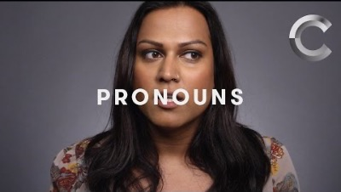
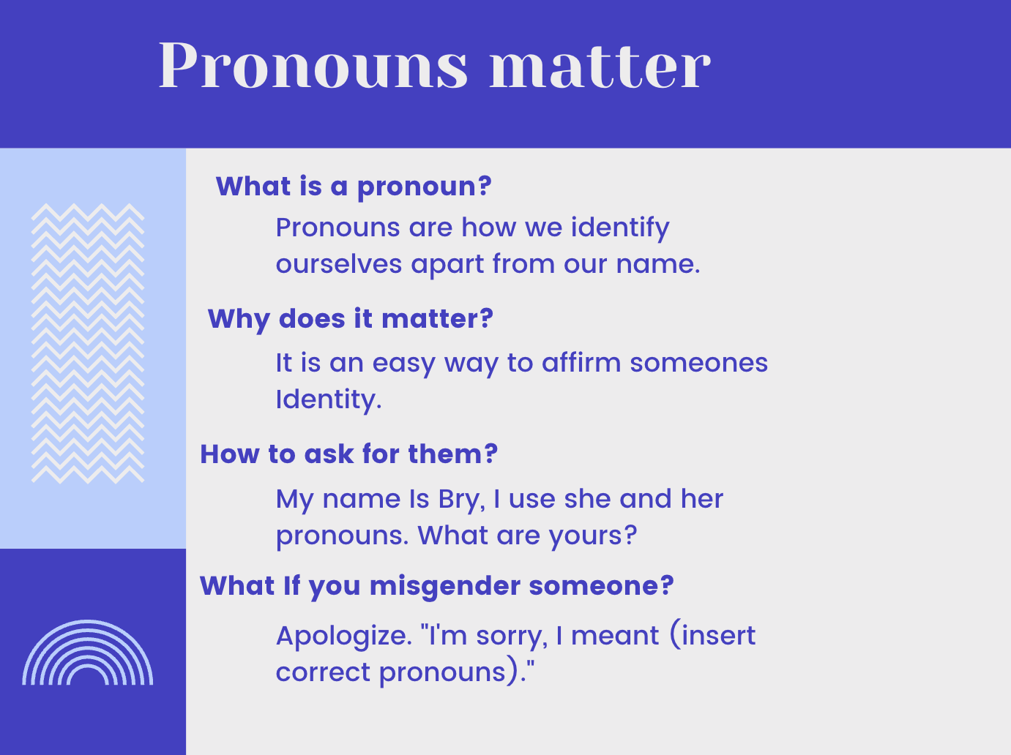
Facebook Content
Pronouns Video
Pronouns Information
Notes:
https://youtu.be/N_yBGQqg7kM
https://www.npr.org/2021/06/02/996319297/gender-identity-pronouns-expression-guide-lgbtq

Slide 8
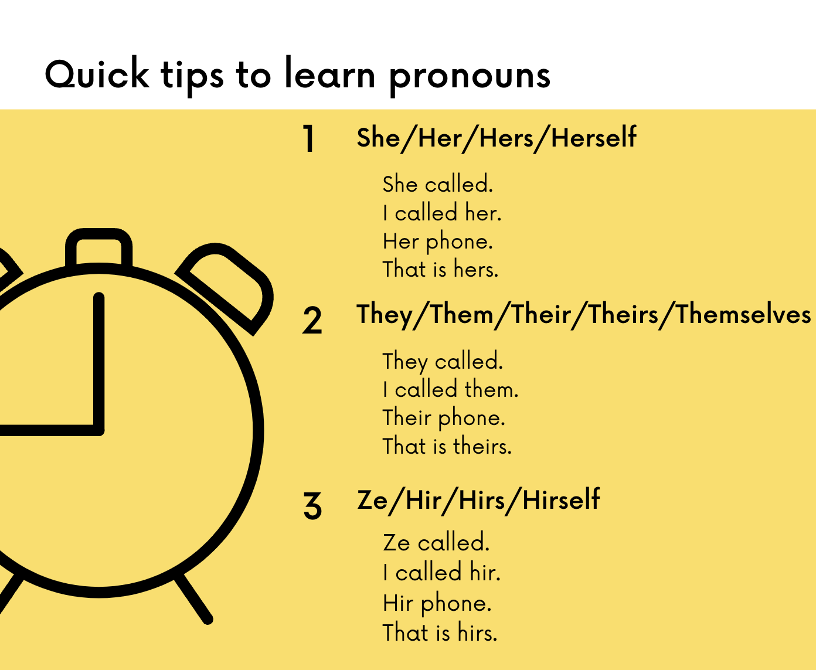
Facebook Helpful Tips

Slide 9
We want to introduce the different pronouns and help people learn how to discuss them as people have increasingly been using different gender identities and being misgendered can be hurtful. Hearing and seeing people use their pronouns will provide a foundation for people to reflect on. Having an easy guide on a few of the pronoun options can be remembered or saved for later.
Notes:
https://www.thehrcfoundation.org/professional-resources/talking-about-pronouns-in-the-workplace

Slide 10

Instagram Content
Shareable Stories Idea

Slide 11
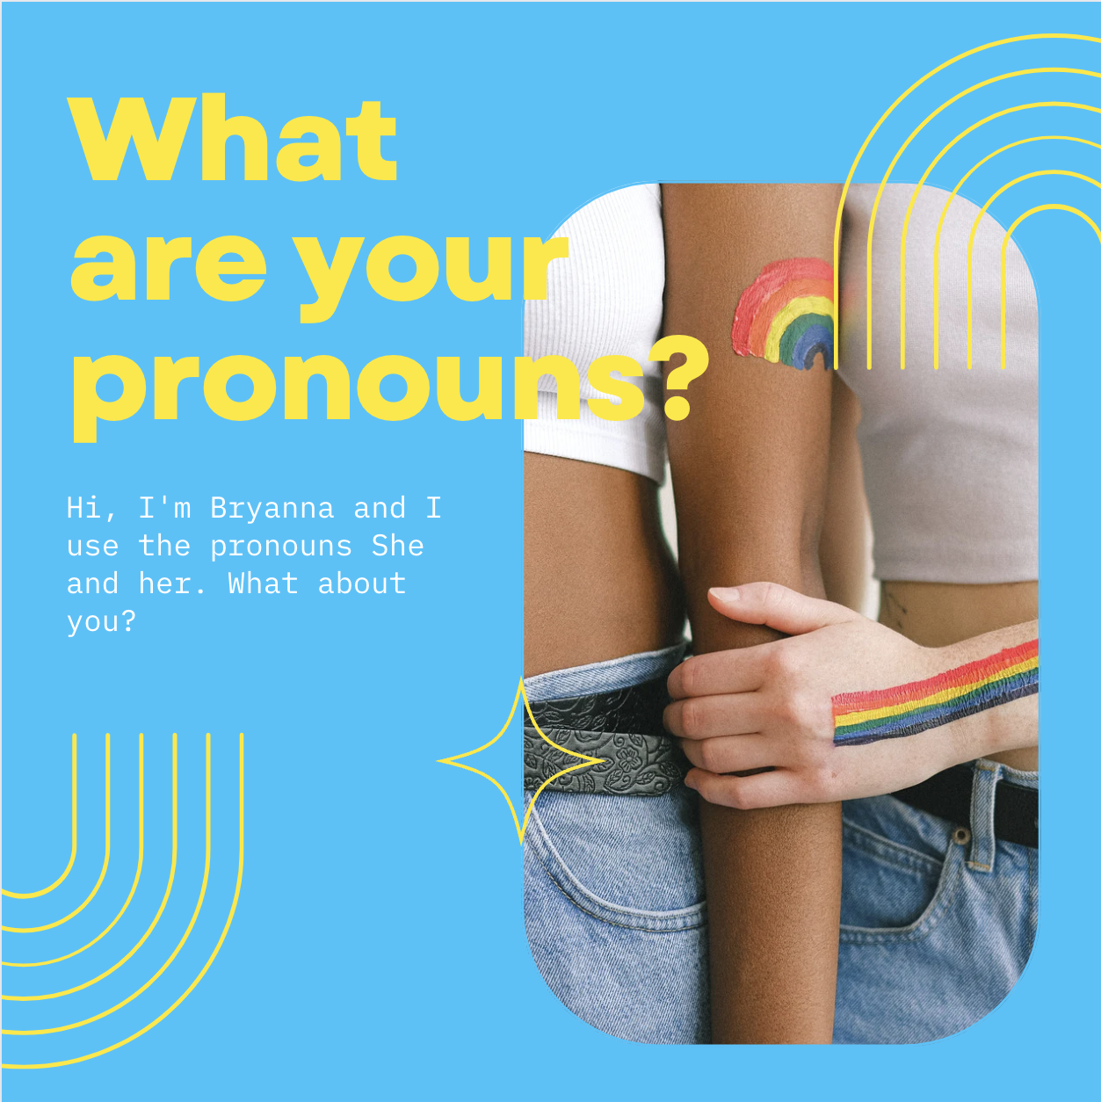
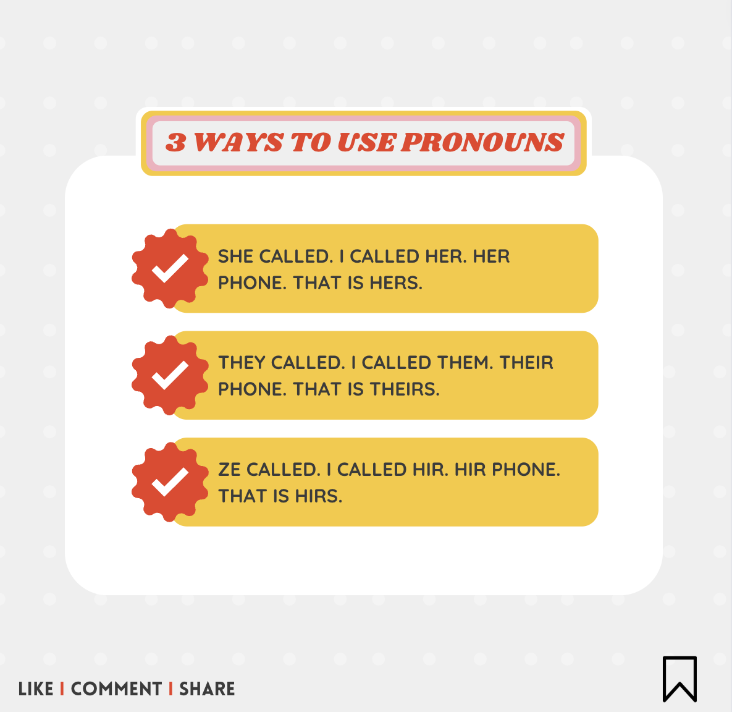
Instagram content, cont.
Caption: If you find yourself unsure of someone's pronouns, listen to how others address them. If you are still unsure, start with your own.
Caption: Common pronouns are She/Her, He/Him, They/Them, and Ze/Zir
Notes:
https://www.glaad.org/transgender/allies

Slide 12
Pew Research detailed that 73% of those aged 18-29 and 65% of those aged 30-49 have heard of or used pronouns. we will be able to engage with this demographic and allow them to express themselves. With increased engagement, we can have more people learn and enter the conversation. Including a quick guide can help people feel more comfortable using them.
Notes:
https://www.pewresearch.org/fact-tank/2019/09/05/gender-neutral-pronouns/

Slide 13
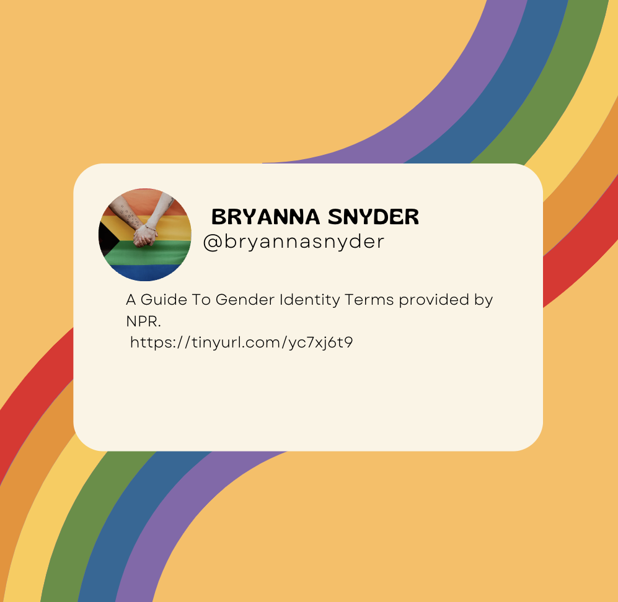
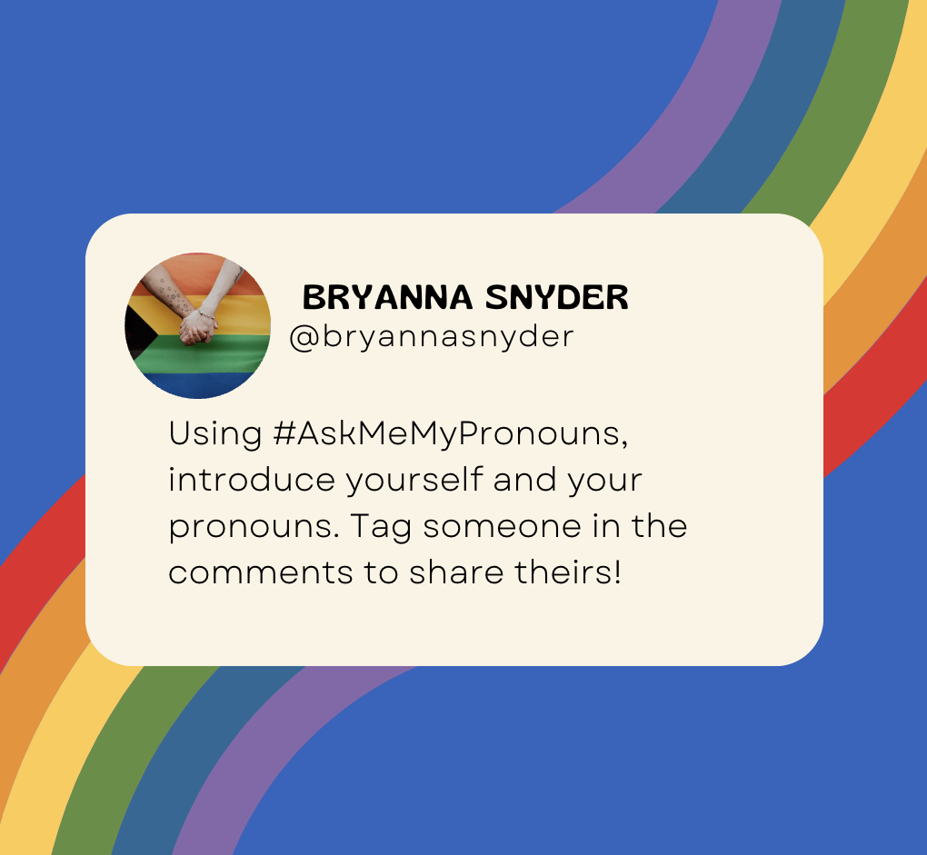
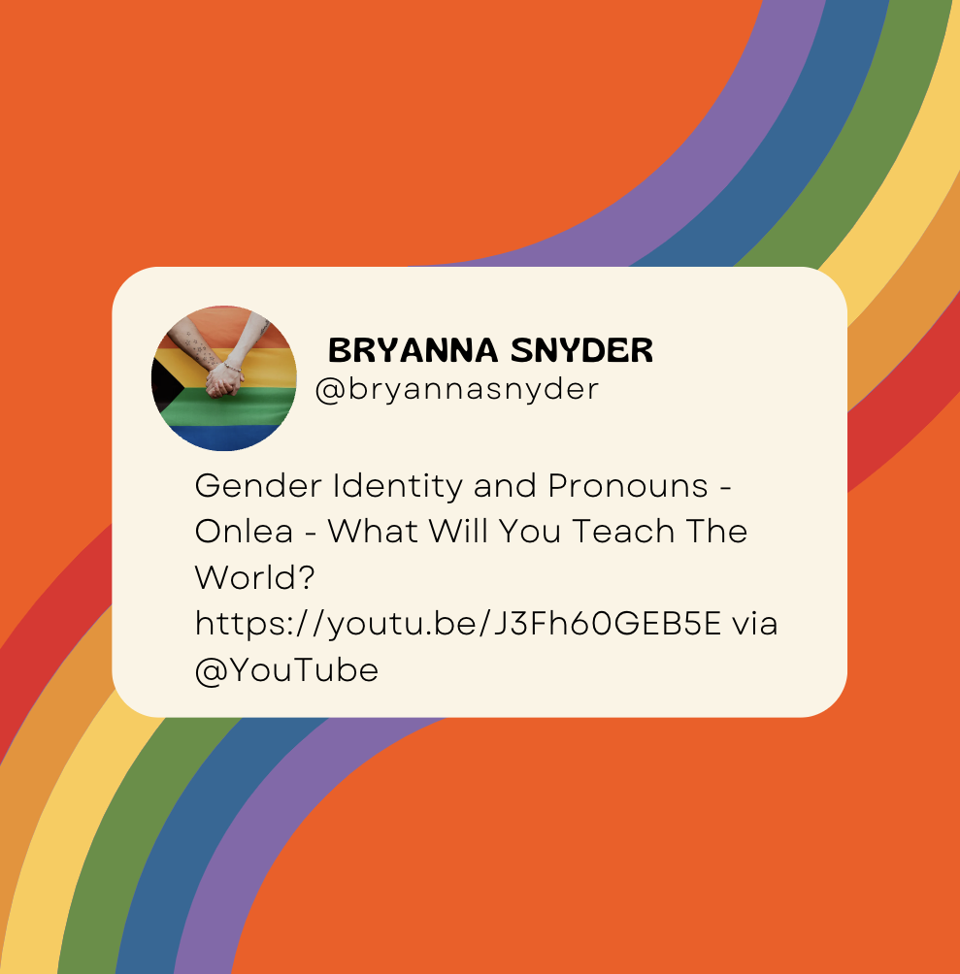
Twitter Content
NPR Article
Pronouns Discussion
Gender Identity Video

Slide 14
56% of Gen Z respondents know someone who uses gender neutral pronouns. By providing them with the space to share and inform others of their pronouns, we can open the conversation. Including article and video links, we will allow people to learn more on their own.
Notes:
https://www.pewresearch.org/fact-tank/2019/09/05/gender-neutral-pronouns/

Slide 15
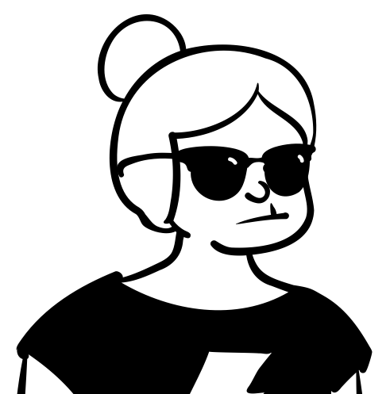
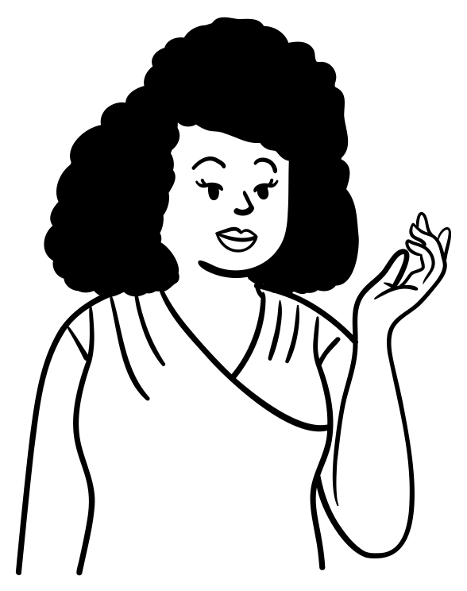
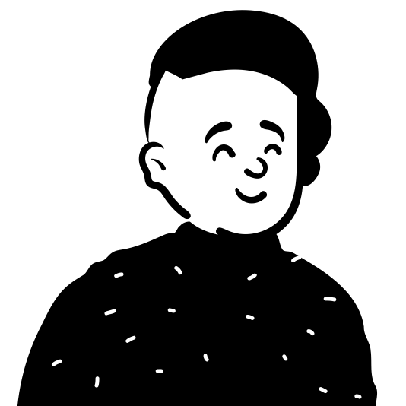
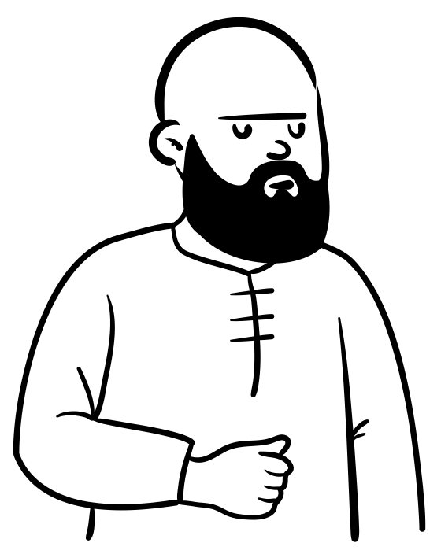
Don’t assume pronouns
Jane Doe
Jesse Jones
Joe Citizen
John Smith
She/Her
Ze/Zir
He/Him
They/Them

Slide 16

Moving Forward
We aim to teach and share pronouns with the world so that we can learn to respect one another and make pronoun, and speaking of them, ordinary.
The biggest challenge would be teaching the older generation. They have gone their entire lives thinking that gender is binary and do not interact with gender identities as often as Generation Y and Z. Building a knowledge base and habit will take more work and repetition.
Shifting our culture and the language we use will also be a barrier, but binary people will learn through the uncomfortable phase into an understanding and acceptance, eventually.
Notes:
https://www.parents.com/parenting/dynamics/lgbtq/from-gen-z-to-gen-x-how-different-generations-talk-about-gender-identity/

Slide 17
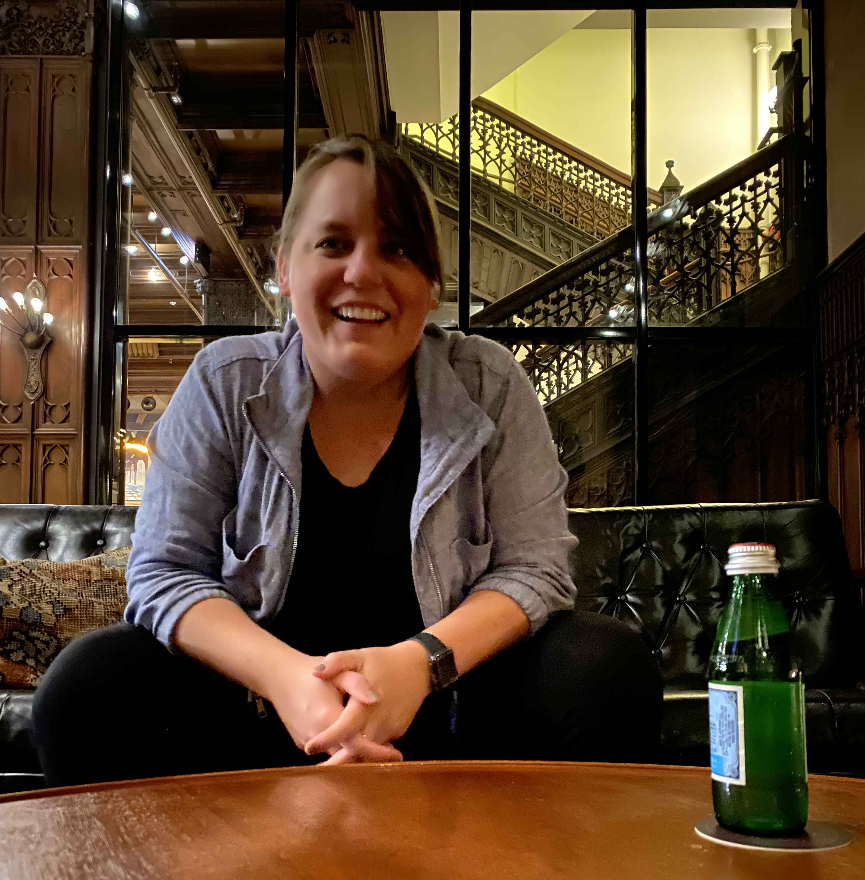
Thank you
Bryanna Snyder
She/Her
bms85@pitt.edu

